Slide 1
Show me the Evidence: Linking Distributional and Macroeconomic Outcomes
IMF Flickr

Slide 2
Focus of this session:
Linking gender inequality to macroeconomic outcomes and policies
Inequality
Legal rights, education, health, financial inclusion
LFP, wages,
representation/
leadership
Macro Outcomes
Economic growth and resilience,
macro-financial stability
Policies
fiscal, monetary, structural, financial

Slide 3
In this presentation we will explore the economic gains from better allocation of talents
Why? What are the channels?
What is the empirical evidence?
Is there room for economic policy?
Country Cases

Slide 4
Why does female economic empowerment boosts GDP?

Slide 5
Let’s look at GDP
GDP through Demand Side = C + I + G + (X – M)
Consumption: Living Standards Measurement Studies (LSMSs) consistently show that women and men spend money on different items.
Investment: LSMSs consistently show that investment patterns in male-run businesses are different from those of female-run businesses.
Government: government spending affects men and women differently; they also have different needs for public expenditure and are impacted differently by taxes.
Misallocation of talents influences exports and imports opportunities (e.g., through access to credit)

Slide 6
Let’s look at GDP
GDP through Income Factors = W + R + π
Wages: differences in wages are well-established, as well as bias in hiring and promotion.
Rents: Property is unequally distributed between women and men.
Profits: reflect the unequal corporate ownership and access to credit.
GDP through Supply Side (Production):
Note since traditional measures of GDP exclude non-market transactions, women’s unpaid care work and subsistence work are not counted.
Affected by productivity
Notes:
GDP production​ = ∑(Output−Intermediate Consumption)+Taxes on products−Subsidies on products

Slide 7
Let’s look at GDP
Productivity is affected by barriers to women’s economic participation through
education (noting also the importance of mother’s education on children’s future outcomes)
health (maternal health, harmful practices)
legal protection (parental leave, equal pay for the same tasks, anti-discrimination)
access to childcare
house chores, elderly care and other unpaid work
Occupational choices that can lower aggregate productivity are affected by
cultural expectations, stereotypes about skills
lack of networks or mentorships
All these factors generate misallocation of workforce across the economy, lowering aggregate productivity.

Slide 8
Women’s Participation and Economic Activity: Correlations

Slide 9
On growth, eyeballing the evidence gives a striking picture:
Correlation with GDP per Capita Growth, 1990-2010
Check out the data: Gender Inequality Index | Human Development Reports (undp.org)

Slide 10
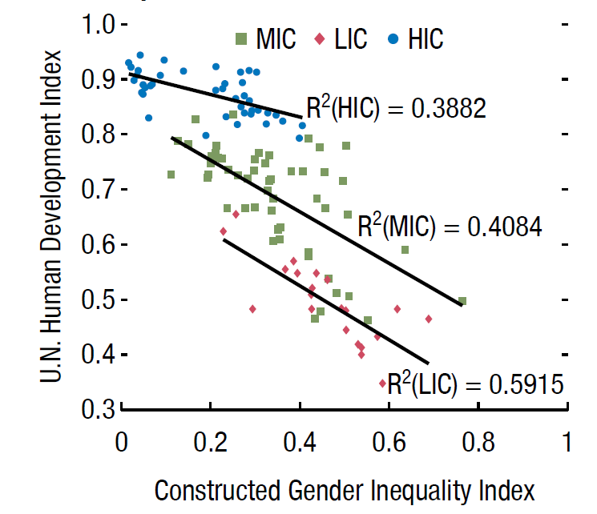
Correlation with Income Inequality in Sub-Saharan Africa…
... with human development
Sources: Solt, Frederick. 2014. "The Standardized World Income Inequality Database" Working paper. SWIID Version 5.0, October 2014; United Nations Development Programme; and Gonzales and others (2015b).
Sources: UN Human Development Index, and IMF estimates. Note: HIC = high-income country; MIC = middle-income country; LIC = low-income country.

Slide 11
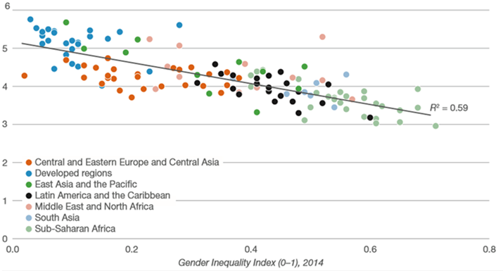
… with global competitiveness
Global Competitiveness Index (1-7)
Source: The Global Competitive Report 2015-2016 (World Economic Forum and United Nations Development Programme: 2015 Human Development Report.

Slide 12
… with export diversification
Some channels:
Less education limit human capital in the economy, constrain the production of new ideas.
Less access to credit and to expand firms to export.
Sources: Kazandjian et al (2016) “Gender Equality and Economic Diversification.” IMF Working Paper 16/140. Data from 1990 to 2013.

Slide 13
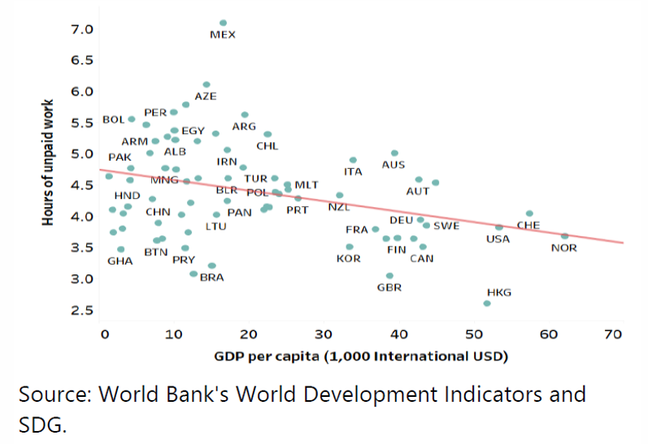
Correlation: more unpaid care work and lower GDP per capita

Slide 14
Women’s Participation and Economic Activity: Empirical Evidence

Slide 15
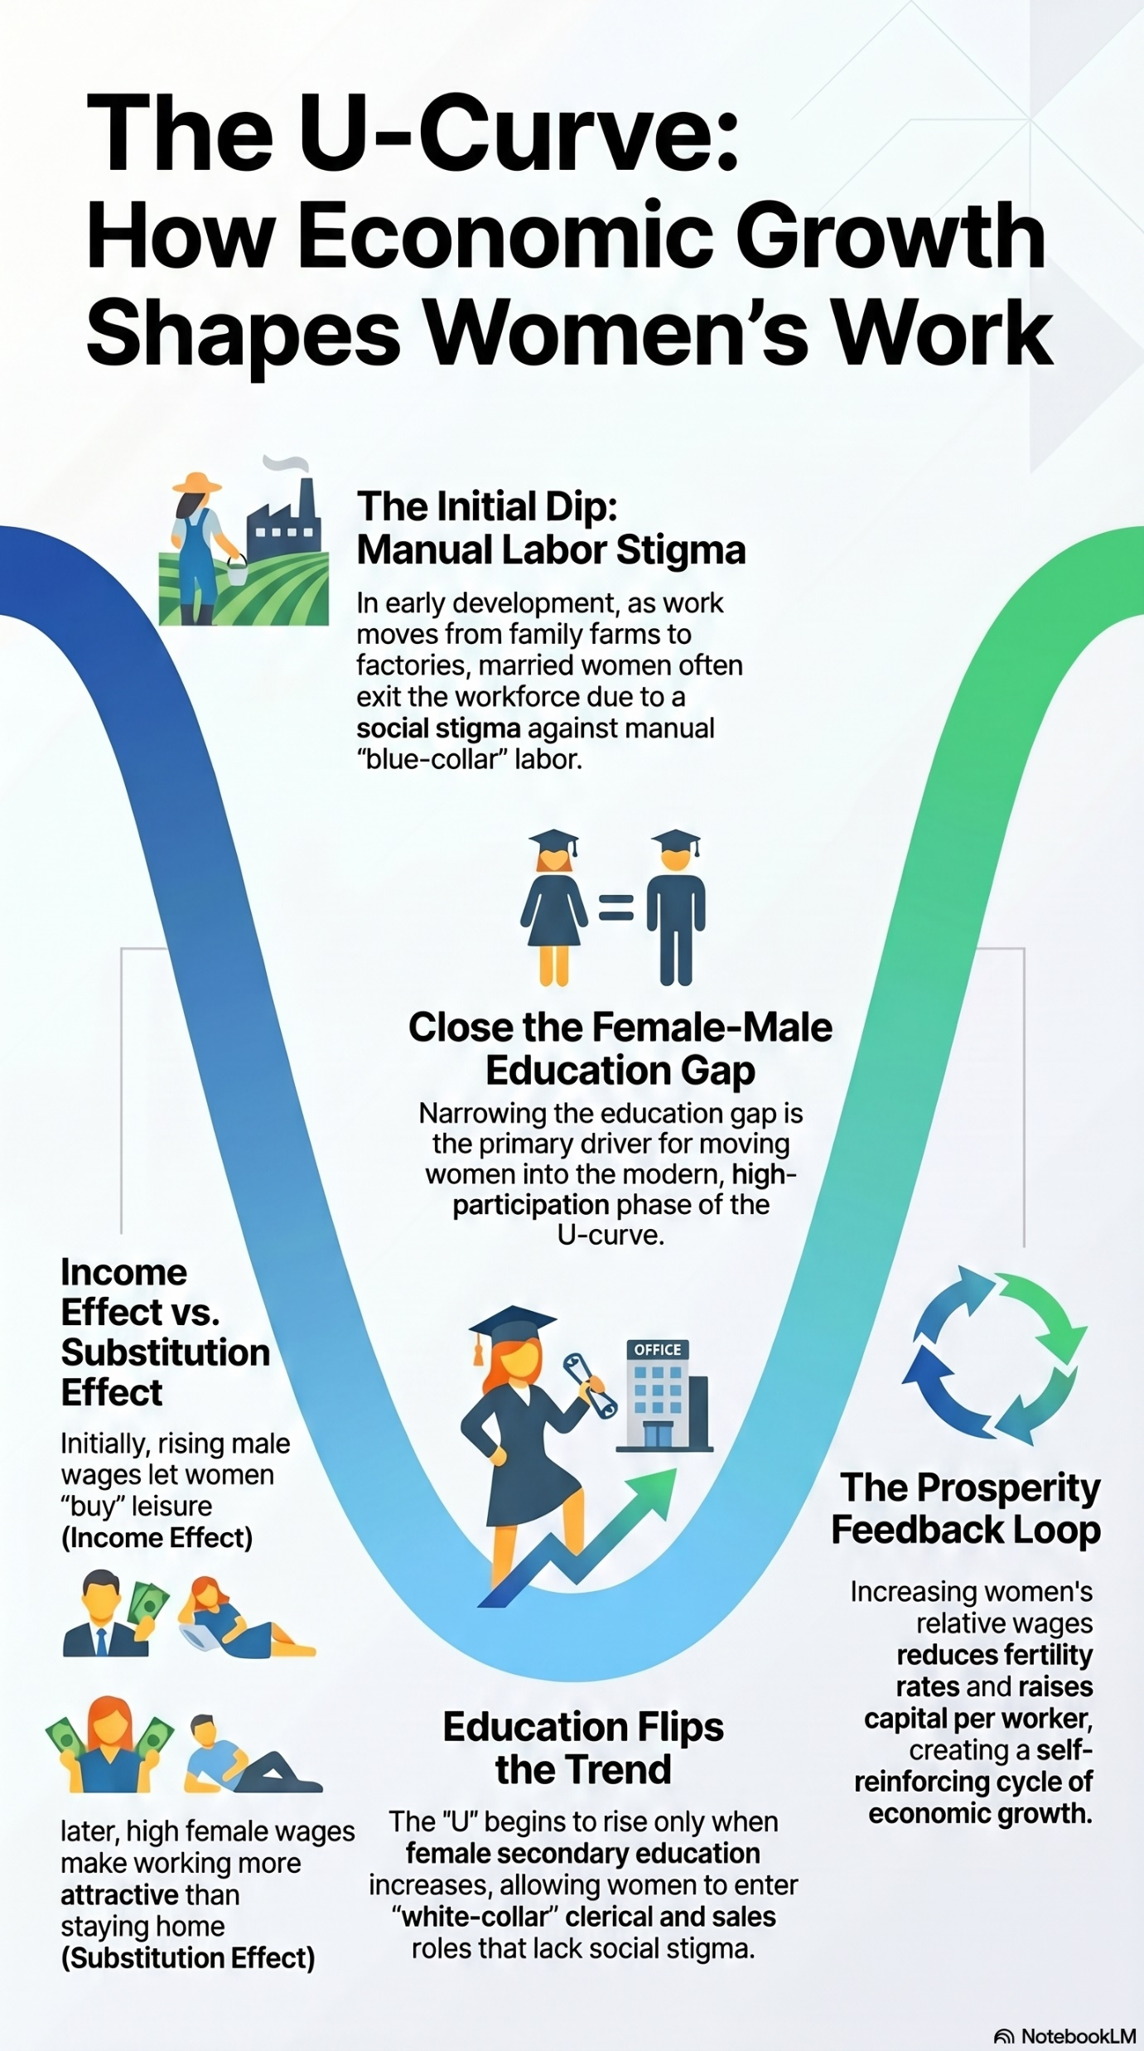
Female LFP and Development
Three seminal papers:
Galor & Weil (1993, 1996):
Claudia Goldin (1995)
Mammen & Paxson (2000)

Slide 16
Cross-Country Data Showed Differences in Female Labor Across Different Development Stages
Claudia Goldin (1995)
Formalized the hypothesis the female LFP forms a U-shape when plotted against economic growth.
Initial decline after agriculture (Income Effect): early industrialization moves labor from family farms to factories. Rising household income from husbands enables married women to exit grueling manual labor.
Eventual Rise (Substitution Effect): As education advances and clean, white-collar service sectors emerge, wages rise. This makes the opportunity cost of staying home too high, drawing women back into the market.

Slide 17
Seminal papers from the 90s found feedback loops from economic growth and demographic transitions
Galor & Weil (1993, 1996):
They demonstrate that as an economy accumulates capital, the relative wages of women rise because capital better complements women's labor inputs (as opposed to physical-strength / intensive tasks)
Higher relative wages increase the opportunity cost of having children, triggering a demographic transition (lower fertility) and boosting female labor force participation
This shift alters household resource allocation—since working women tend to invest a higher share of income into the health and education of their children—accelerating long-term human capital accumulation and economic growth

Slide 18
Cross-Country Data Reinforced Differences in Female Labor Across Different Development Stages
Mammen & Paxson (2000)
They evaluate cross-country data to understand how women's economic activities change as economies modernize.
They document a distinct U-shaped relationship between economic development and female labor force participation.
At low levels of income, women work heavily in family agricultural enterprises
As industrialization pulls work out of the home, participation initially dips due to social stigmas and structural barriers…
… before rebounding strongly as women gain higher education levels, leading to permanent structural growth gains.

Slide 19
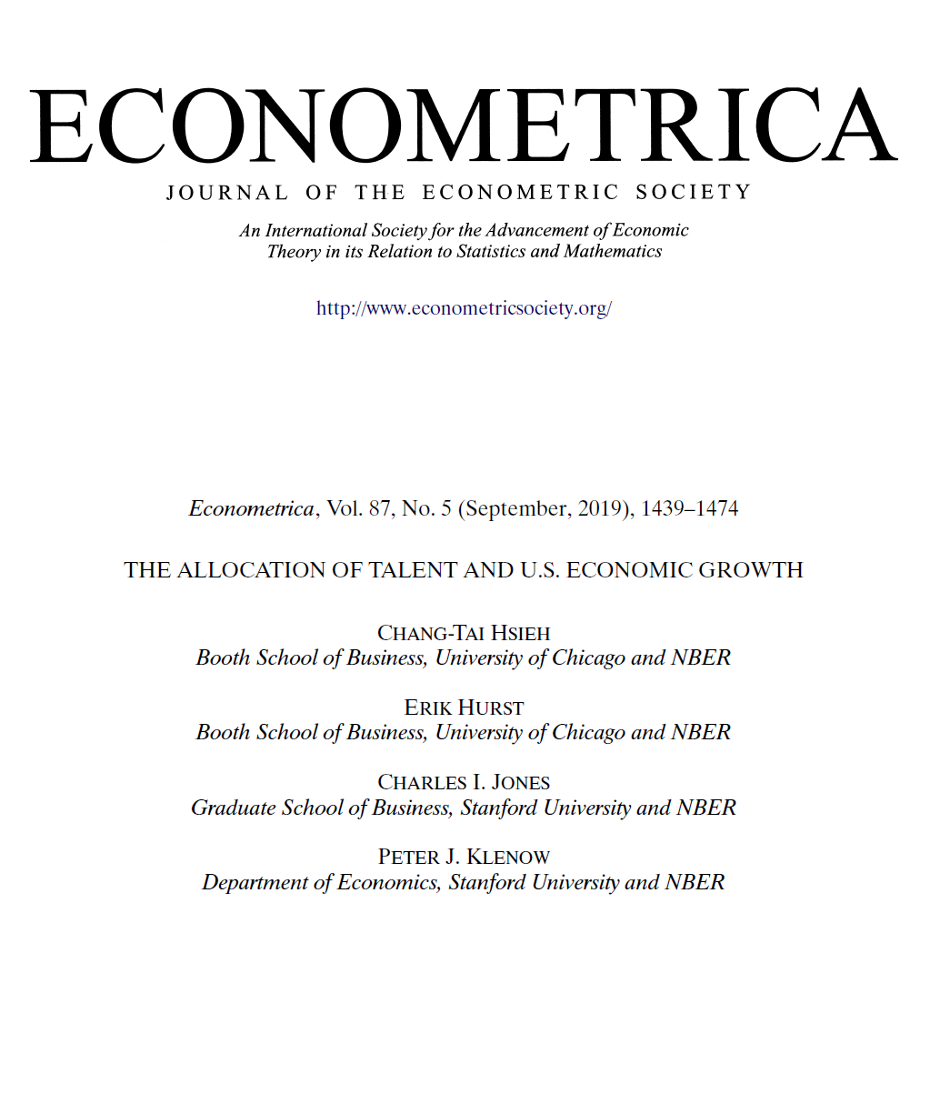
US Economic Growth from 1960 to 2010 largely due to reduction of barriers to women in the labor market
In 1960, 94 percent of doctors and lawyers were white men. By 2010, the fraction was just 62 percent.
Similar changes in other highly-skilled occupations have occurred throughout the U.S. economy during the last 50 years.
Given that the innate talent for these professions is unlikely to have changed differently across groups, the change in the occupational distribution since 1960 suggests that a substantial pool of innately talented women and black men in 1960 were not pursuing their comparative advantage.
The paper examines the effect on aggregate productivity from1960 and 2010 through the prism of a Roy model.
Estimates that 37% of US growth in that period is due to the improved allocation of talent of women.

Slide 20
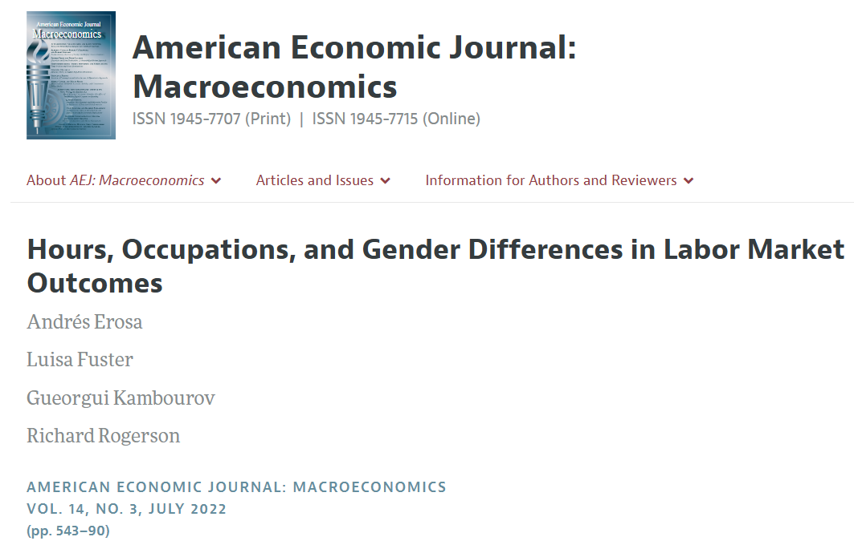
Home production responsibilities in the US in the 80s and 90s affecting female economic outcomes
Goldin (2014) offers a narrative in which differences in home production responsibilities create gaps in labor market outcomes.
Quantitative assessment of this narrative found that the fact that women spent much more time in home production was responsible for a large share in differential economic outcomes: occupational choice, wages, and hours.
Notes:
Goldin, Claudia. 2014. “A Grand Gender Convergence: Its Last Chapter.“ American Economic Review, 104(4): 1091{1119.

Slide 21
Home production responsibilities changes occupational choices, wages, and hours
Outcome | Observed Gender Gap in Data | Model-Predicted Gap (Baseline) | % of Observed Gap Explained by Model
Wage Gap (log wages) | 42% | 12% | 29%
Hours Gap (log hours) | 27% | 29% | 107%
Occupation Gap (% in high-hour occupation) | 23 pp | 9 pp | 39%
Wage decomposition: within-occupation (75%), across occupation (25%)
The paper fins that, if a Social Planner could reallocate home production time efficiently…
Welfare would increase by 8.4% (in consumption-equivalent terms)
Output per hour worked would rise by 3.4%

Slide 22
Going global: closing gaps in entrepreneurship, self-employment, and labor force participation
Cuberes and Teignier (2014) simulates an occupational choice model with heterogeneous agents in entrepreneurial ability, where agents choose to be workers, self-employed or employers.
Basic assumptions:
Equal distribution of talents for men and women (both smart men and women, and less smart men and women…)
Restrictions on what women can do:
Only a share of all women can join the labor market.
Only some of those can be self-employed.
And even less can hire employees themselves.
Potential Market Gains due from Closing Gaps in Economic Participation (Percent of GDP)
Notes:
The model evaluates how restrictions on female employment and entrepreneurship reduce aggregate productivity and income per capita.
The analysis is global, covering 126 countries, including both developed and developing economies.
Data is sourced from the International Labour Organization (ILO) and simulations are conducted country by country, with results presented by region.

Slide 23
Gender equality can amplify the impact of structural reforms:
Output gains from Major Historical Reforms
(% of output)
Average for EMDEs:
23 percent
Source: The first four columns are from WEO (IMF, Oct. 2019, Ch. 3), model simulated, based on actual reforms. The fifth column is based on Ostry and others (2018), updated by staff assuming all countries reduce gender gaps in line with what the top 5% best performing countries achieved during 2014-19.
Source: Ostry and others (2018). Based on 128 countries. For gains be realized, various frictions such as financial barriers and informality would need to be addressed, requiring both broad macro-structural reforms and reforms to specifically tackle the frictions that hinder the closing of the gender gaps.
3.
Notes:
This slide presents the gains from structural reforms and from closing gender gaps in labor force participation, based on feasible scenarios in both areas.
The first four columns in the left chart show the sizable model-based gains from major structural reforms, based on actual reforms, as published in the 2019 October World Economic Outlook.
The last column in the left chart presents the model-based gains from reducing gender gaps using the methodology presented in a 2018 Staff Discussion Note. The results suggest that reducing gender gaps in line with the average decrease seen in the 5 percent of countries that saw the largest gender gap reductions between 2014 and 2019—that is mirroring a reasonable medium-term change—could yield an average GDP gain of 7.7 percent (albania 9%, UAE 8.7%, Malta 8%<
The chart on the right illustrates the potential GDP gains from closing gender gaps in labor force participation in 128 emerging and developing economies, a longer-term scenario. The GDP gains from such a decrease could reach 23 percent on average. For it to be realized, frictions such as financial barriers and informality would need to be addressed, requiring both broad macro-structural reforms and reforms to specifically tackle the frictions that hinder the closing of the gender gaps.
Structural reforms are therefore critically important and necessary for growth and improved gender outcomes. At the same time, structural reforms designed without a gender lens are unlikely to be sufficient to reduce gender gaps, and a gender lens can amplify the positive impact of structural reforms on growth. This calls for a systematic and intentional approach to integrating gender into reform design.

Slide 24
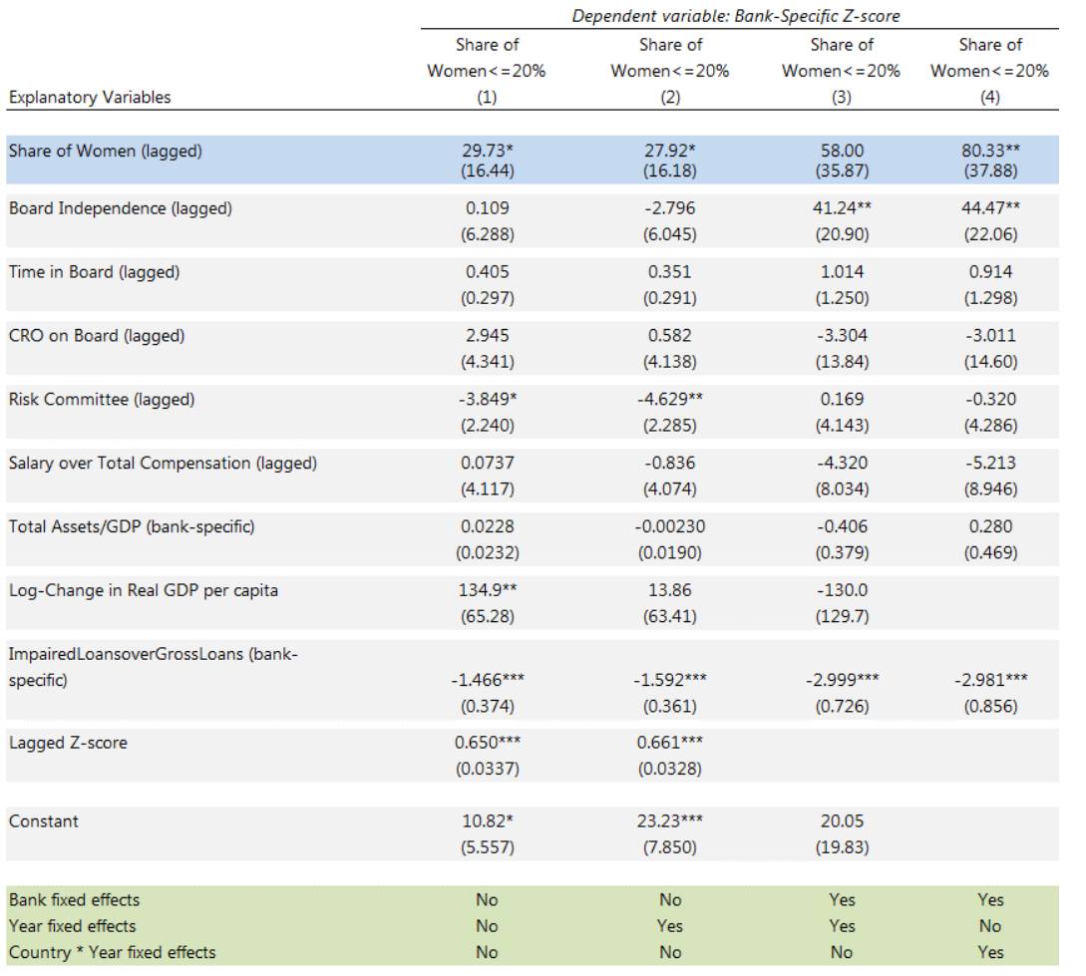

A higher share of women in bank boards in associated with higher financial stability:
Notes:
The dependent variable is bank’s distance-to-distress, also known as the z-score (Zit). Distance-to-distress is defined as the buffers that banks have (capital to assets plus return on assets), scaled by their volatility of returns (standard deviation of return on assets). Higher distance-todistress means that banks’ buffers are higher relative to volatility of their earnings.

Slide 25
Is there room for governments to implement policies and reduce barriers to female economic participation?

Slide 26
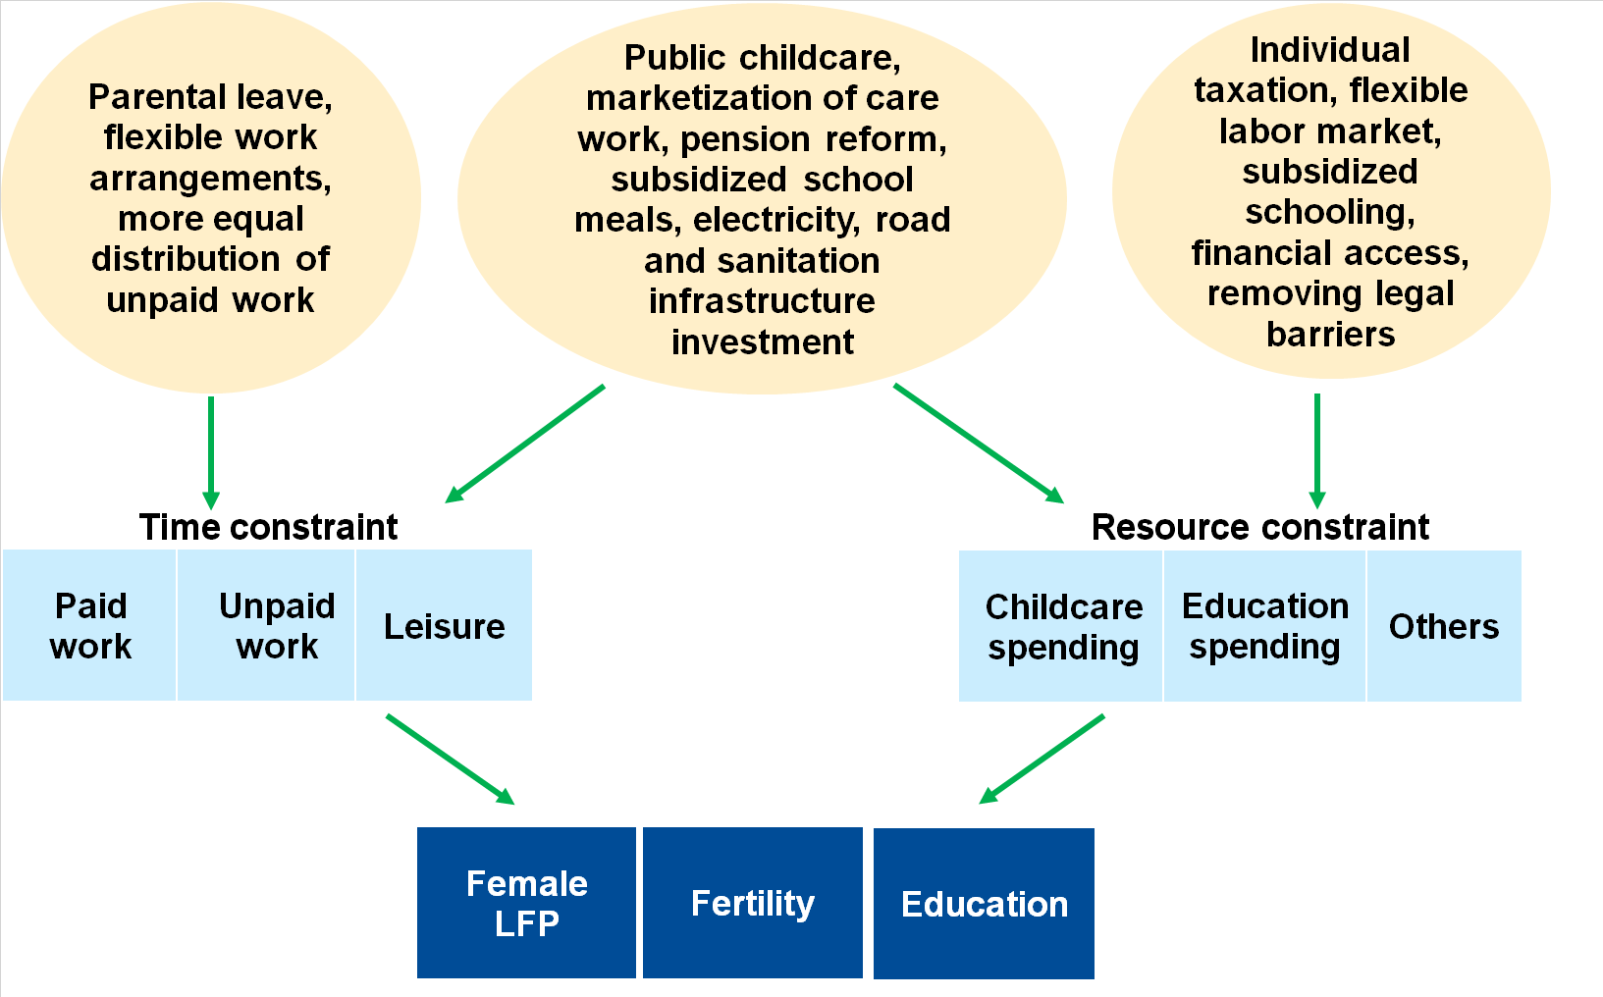
Yes! Indeed, policies should alleviate time and resource constraints
Possible Policies
Constraints
Families’ Decisions

Slide 27
Sources of Legal Impediments
Selected Policies for Women’s Economic Empowerment
Legal reforms
Fiscal policies
Financial sector policies
Policies matter despite social norms:
Constitutional law and civil rights
Family law
Property law
Gender-responsive budgeting
Equal access to digital infrastructure (mobile phones, high-speed internet, digital ID)
Labor market policies
Removing biases in recruitment, promotion and retention policies
Eliminate sexual harassment in the workplace
Labor law
Tax law
Direct/indirect taxation
Spending on education, health, infrastructure and well-targeted social assistance
Training and skills enhancement
Public sector wage policies
Parental leave and child/elderly care
Supervisory guidance for FIs to reduce biases
Investing in digital and financial literacy
Proportionate and risk-based supervision
Taxation
Childcare
Parental leave
Education
Family allowances

Slide 28
Thank you! Get in touch: vmalta@imf.org

